Slide 1
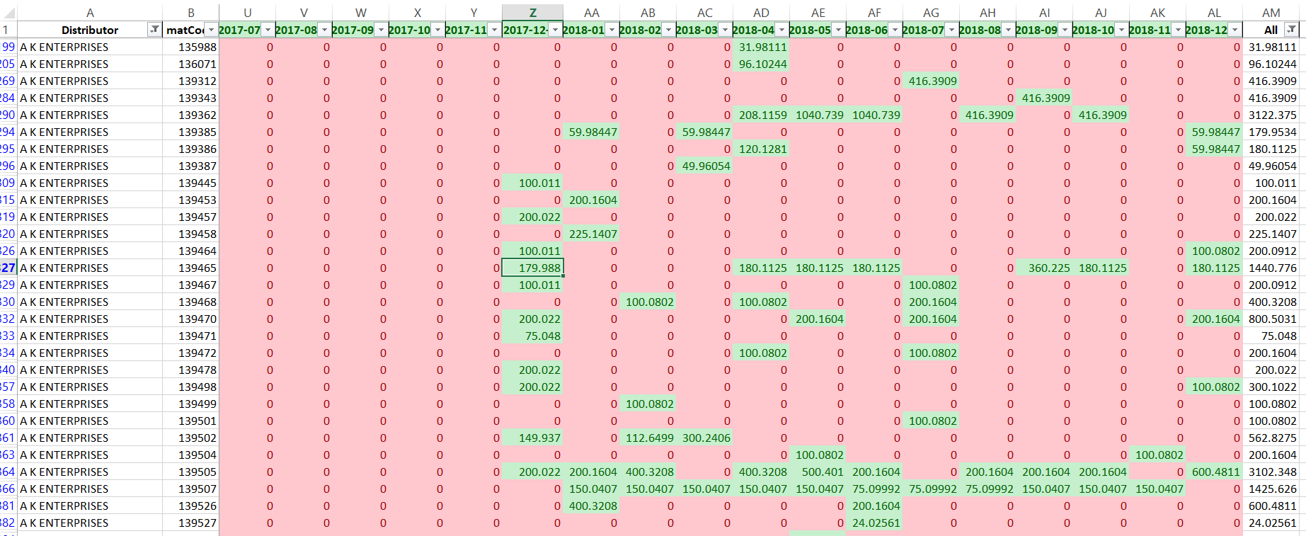
Intermittent Demand Forecast

Slide 2
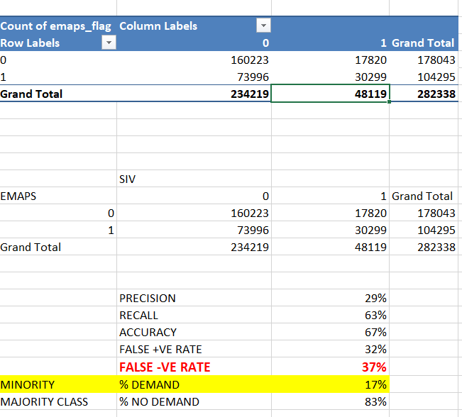
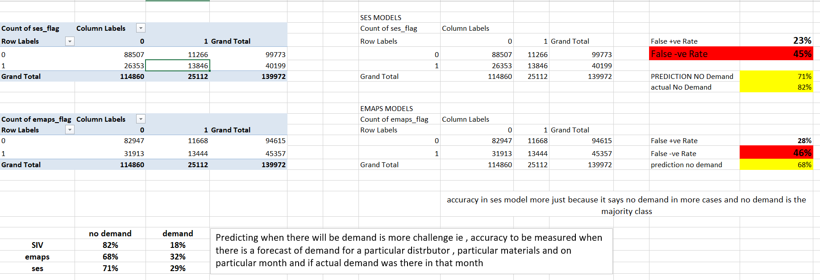

Slide 3


Exponential Smoothing : limitation on the intermittent data

Slide 4
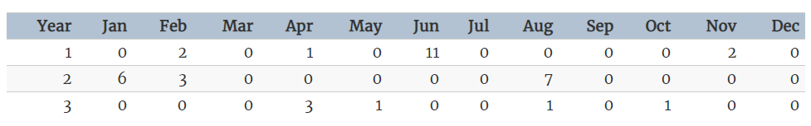
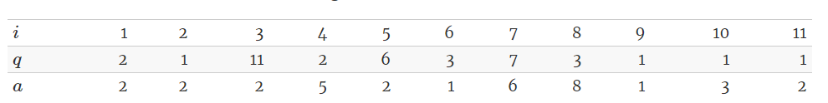

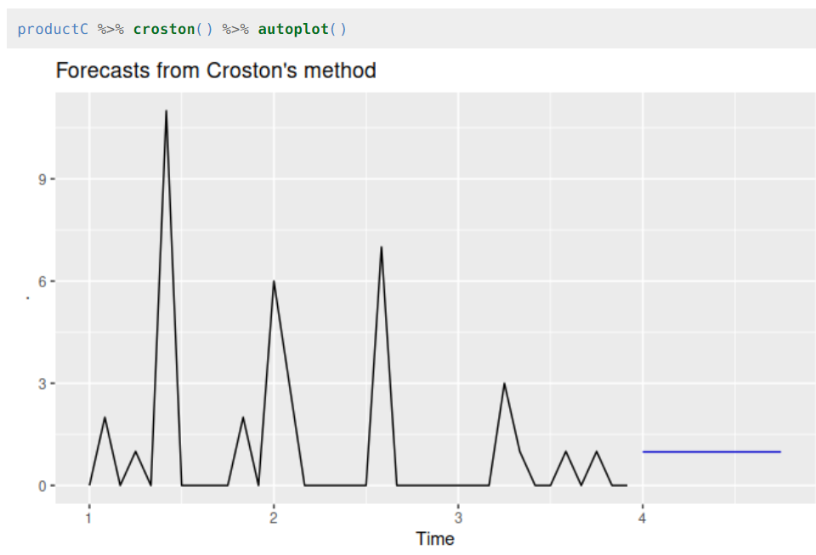


Croston's Method for intermittent demand forecast

Slide 5


Further Modification on Croston’s method
SBA MODEL : Syntetos and Boylan (2001) showed that Croston’s method is biased, due to the division, and suggested a modified version (Syntetos and Boylan, 2005):
where x is the smoothing parameter for xt. This modified version has demonstrated good empirical performance, superior to the original method (Syntetos and Boylan, 2005, 2006).
TSB MODEL Teunter et al. (2011) observed that Croston’s method is unsuitable to deal with obsolescence issues, because of the limited updates of ˆzt and ˆxt,
two vectors are considered; the demand probability dt and the demand size zt. The demand probability is either 0 or 1 depending whether demand occurs at time t or not and is modelled using single exponential smoothing.
The demand probability estimate, ˆ dt, is updated at the end of every period. The demand size is also modelled with a single exponential smoothing, but is updated only when a positive demand occurs.
Each smoothing model uses a separate parameter, recognizing the need for different rates of updates.
Teunter et al. (2011) argue that the smoothing parameter of demand probability should be smaller than the smoothing parameter of demand size.
The forecast of this method is:

Slide 6
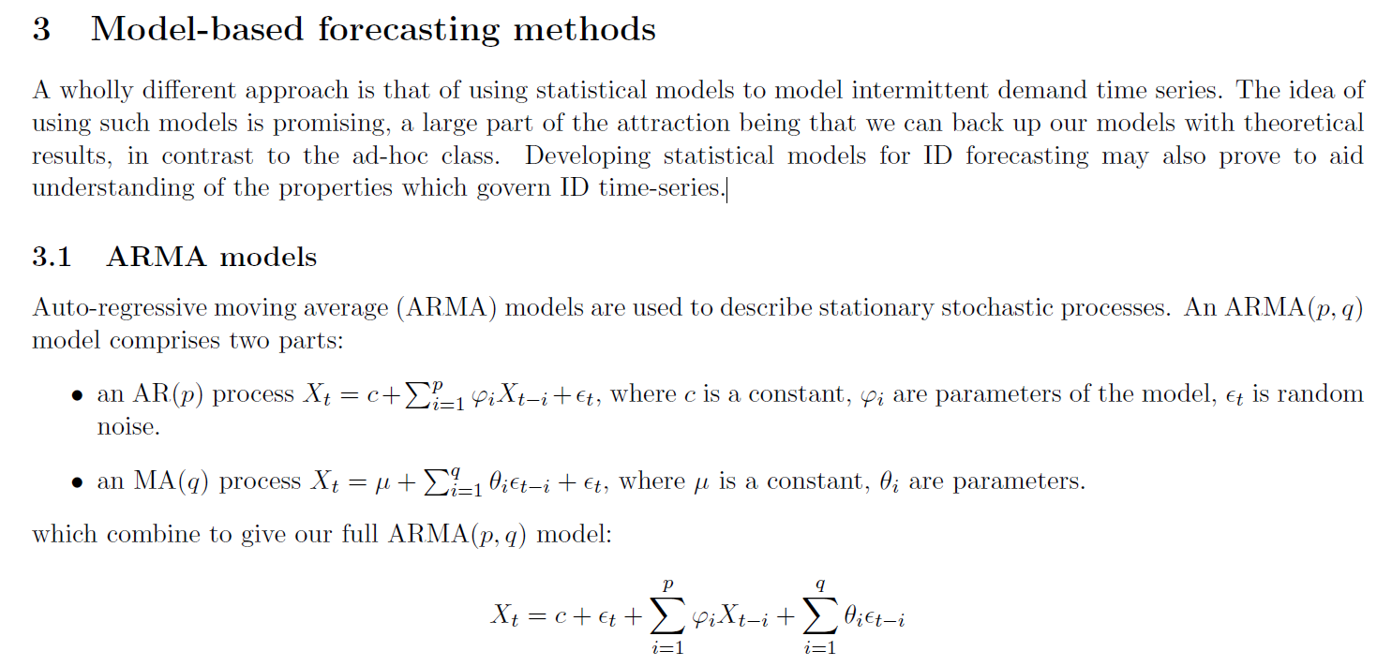
Time Series Model Adjustments

Slide 7
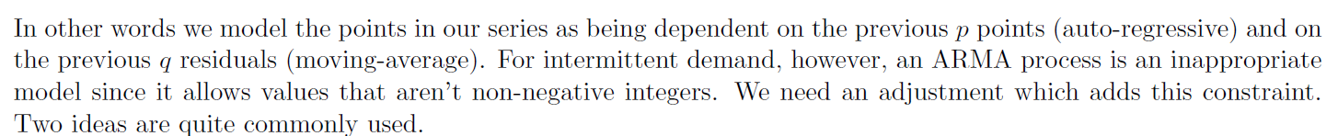
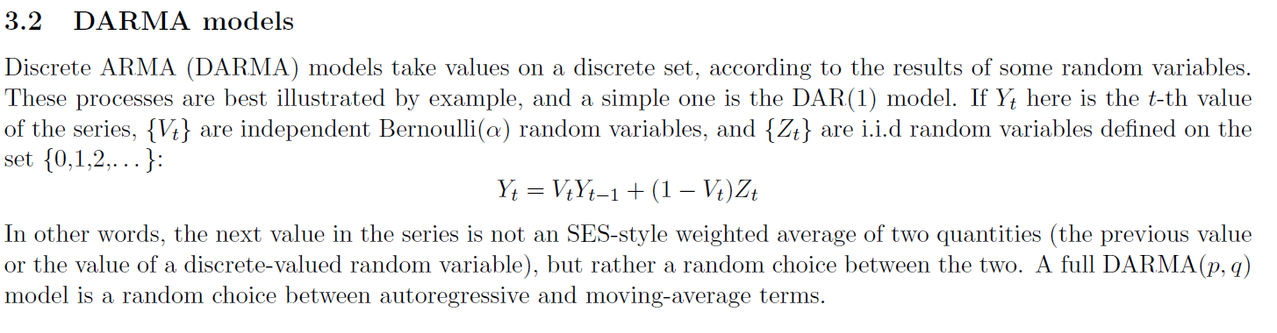

Slide 8
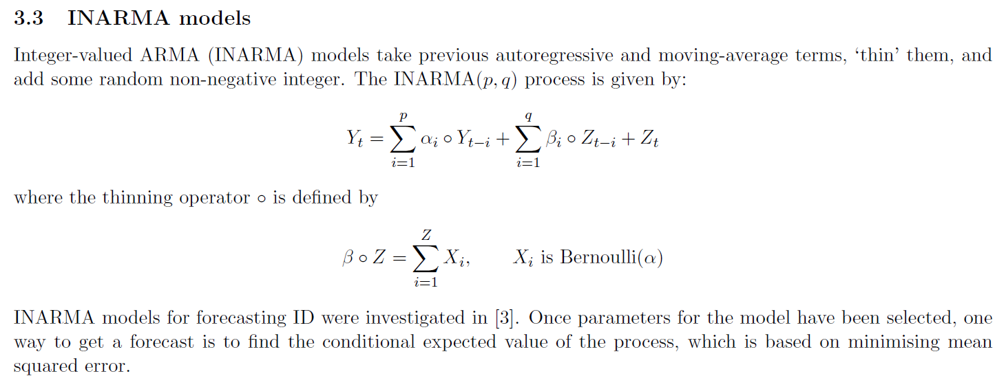

Slide 9
Feature Creation Overview
Calculate The Following Fetaures
Make A Quarterly Demand Forecast | Quarterly Demand Forecast On Distributor Level | Time Series Models : Ema , Holt, Holt Winter , Arima May Be Tried
Balance Expected Demand | = Expected Qtr Demand Forecast - Running Total Of Demand Till Month
Month As A Feature | = Find Out Which Months See Higher Demands In History
Month Index Of Quarter | = 1st /2nd/3rd Month Of The Quarter
Quarter As A Feature
Avg Quarterly Demand As A Feature | On Distrbutor Level
Avg Monthly Demand As A Feature | On Distrbutor Level
Month Since Last Pruchase From Current Month | Var X
Mean Interpurchase Month Time | Var Y
Ratio Of X/Y | Highrt Ratio Inidicates A Larger Propensity Of Seeing A Demand

